Slide 1

Deliverable 2
The Strawberries:
Mariana F., Tiba H, Vassiliki K., Natacha S.

Slide 2

Tasks Breakdown and Assignments (part 1)
Strawberry | Task/User story | Duration
Mariana | I am a user and I would like to draw a wire so I can set up a circuit | 3 day
Mariana | I am a developer and I would like to save the electrical components in a Tree so I can keep track of the start and end of a circuit | 1 day
Vassiliki | I am a user and I would like to detect a shot circuit so that I can understand how this case works | 1 week
Mariana | I am a user and I would like a drag and drop feature so I can easily place components | 3 days
Natacha | I am a user and I would like to have a user-friendly UI to easily navigate through the program | 2-3 weeks
Tiba | I am a user and I would like the option to place a battery in the circuit so that I can power it and test my design | 4 days
Vassiliki | I am a user and I would like to place resistors in my circuit so that I can design a more complex circuit | 4 days
Tiba | I am a user and I would like to place switches in my circuit so that I can control the flow of electricity | 4 days
Natacha | I am a user and I would like my components to be displayed with proper icons and labels so that I can easily distinguish between different elements | 1 week
Natacha | I am a user and I would like to see the total voltage/resistance/current in my circuit so that I know how the circuit is functioning | 4 days

Slide 3
Tasks Breakdown and Assignments (part 2)
Strawberry | Task/User story | Duration
Vassiliki | I am a user, and I would like the program to apply real-world electrical laws so that I can accurately simulate and analyze circuit behavior. | 2 weeks
Vassiliki | I am a user and I would like to see the polarity of components so that I can correctly connect elements with positive and negative terminals. | 4 days
Mariana | I am a user and I would like to implement a fuse in my circuit so that I can prevent damage from excessive current. | 3 day
Mariana | I am a user and I would like to add a light bulb to my circuit so that I can visually represent electrical flow. | 3 days
Mariana | I am a user and I would like to include a capacitor in my circuit so that I can simulate energy storage and discharge. | 3 days
Natacha | I am a user and I would like to display a graph so that I can visualize circuit parameters over time. | 2 weeks
Tiba | I am a user and I would like to collect data for capacitor energy vs. time so that I can analyze how capacitors charge and discharge. | 4 days

Slide 4
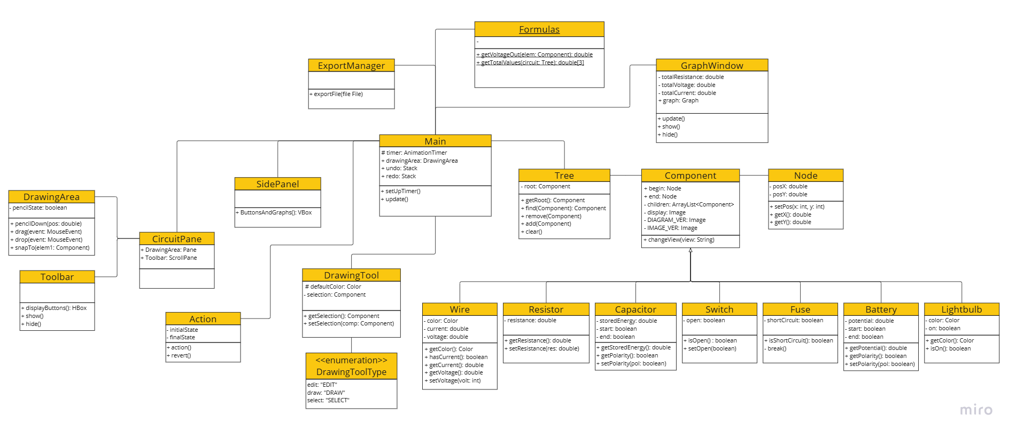
UML Class Diagram

Slide 5
Sample Input and Output Data Grid
Feature | Sample Input | Sample Output
Show component polarity | Battery polarity: + and -, Capacitor polarity: + and - | The components show polarity indicators (+/-)
Fuse implementation | 10V source, 5Ω resistor, 1A fuse | If current is bigger than 1A, fuse blows and circuit breaks
Light bulb implementation | 5V source, light bulb component | Light bulb turns on and “glows” when connected to a functional circuit
Capacitor Implementation | 10V battery, 100µF capacitor, switch | Capacitor charges when switch is closed, discharges when opened.
Graph Display | Energy and time for capacitor charging and discharging | Line graph displaying exponential charge curve over time.
Total Voltage/Resistance/Current | Circuit with 9V battery, 3Ω & 6Ω resistors in series | Voltage = 9V, Resistance = 9Ω, Current = 1A
Short Circuit Detection | Wire directly connecting both terminals of a 5V battery | System alerts user of a short circuit and disables simulation.

Slide 6
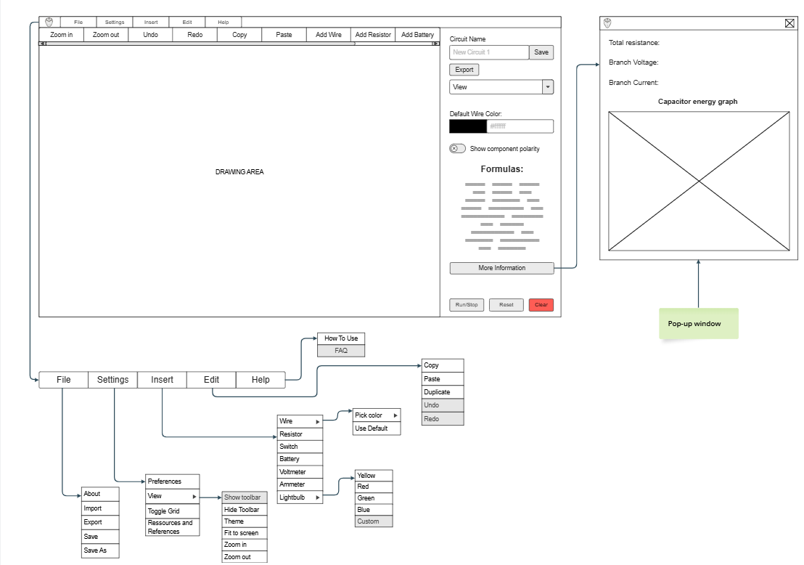
Wireframe (overview)

Slide 7
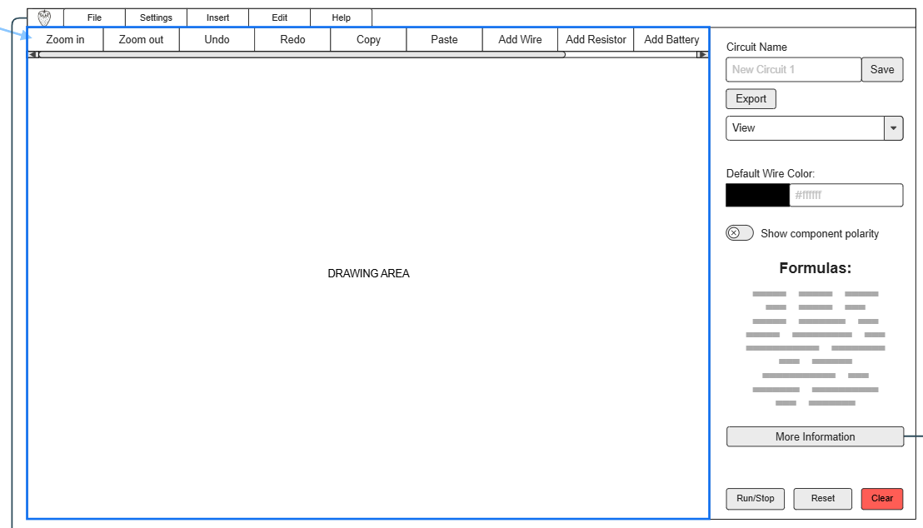
Wireframe

Slide 8
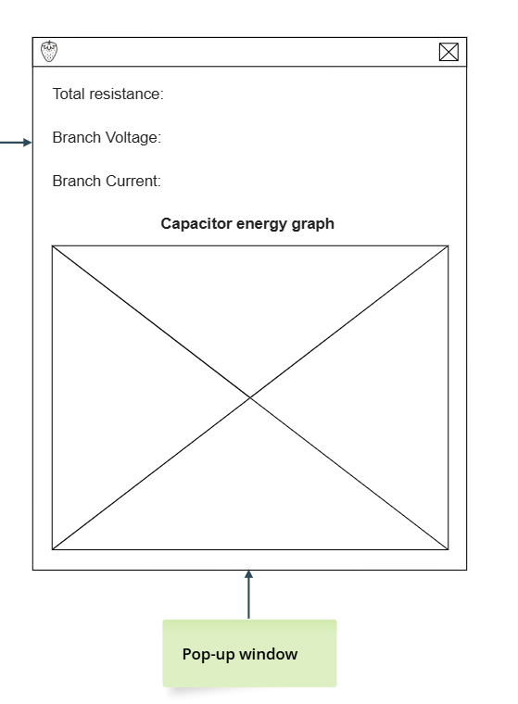
Wireframe

Slide 9
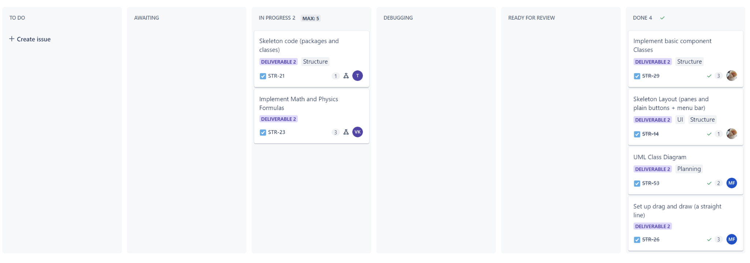
Sprint Report

Slide 10

Sprint Report - Team table
Received Stories | Resolved Stories | Carry-over Stories | Blocked Stories
STR-14 Skeleton Layout (1) | STR-14 Skeleton Layout (1)
STR-21 Skeleton Code (1) | STR-21 Skeleton Code (1)
STR-23 Math & Physics Formulas (2) |  | STR-23 Math & Physics Formulas (2)
STR-26 Set up drag and draw (4) | STR-26 Set up drag and draw (4)
STR-29 Implement Basic Component Classes (2) |  | STR-29 Implement Basic Component Classes (2)
Total Points: 10 | Total Points: 6 | Total Points: 4 | Total Points:

Slide 11

Sprint report - Mariana
Received Stories | Resolved Stories | Carry-over Stories | Blocked Stories
UML diagram (1) | UML diagram (1)
Drag and draw (4) | Drag and Draw (2)
Total Points: 5 | Total Points: 5 | Total Points: 0 | Total Points:

Slide 12
Sprint report - Tiba
Received Stories | Resolved Stories | Carry-over Stories | Blocked Stories
STR-21 Skeleton Code (1) |  | STR-21 Skeleton Code (1)
Set up classes and methods (1) | Set up classes and methods (1)
Total Points: 2 | Total Points: 1 | Total Points: 1 | Total Points:

Slide 13
Sprint report - Vassiliki
Received Stories | Resolved Stories | Carry-over Stories | Blocked Stories
STR-23 Circuit laws (3) |  | STR-23 Circuit laws(3)
STR-31 Battery implementation (3) | STR-31 Battery implementation (3)
Total Points: 6 | Total Points: 3 | Total Points: 3 | Total Points:

Slide 14
Sprint report - Natacha
Received Stories | Resolved Stories | Carry-over Stories | Blocked Stories
STR-29 Implement Basic Component Classes (3) | STR-29 Implement Basic Component Classes (3)
STR-14 Skeleton Layout (1) | STR-14 Skeleton Layout (1)
Total Points: 4 | Total Points: 4 | Total Points: | Total Points:

